Slide 1

Drunk Driving Prevention
권수환, 이승화, 전주영
https://github.com/banksemi/drunk-driving-detection

Slide 2
Introduction
Demo
Implementation
Marketing Plan
Future works
Drunk Driving Prevention
INDEX
graduation project

Slide 3
Introduction
State of Drunk Driving
15%
Drunk driving experience
Respondents who have drunk driving in 1 year
https://kr.investing.com/news/economy/article-125518

Slide 4

Introduction
Our Project
Drunk Driving Prevention
Increased awareness of drunk driving
Actual drunk driving does not decrease
Solve

Slide 5
Introduction
Objective
01
Drinking Detection
02
Drinking Management
It can measure drinking frequency, intensity
This wall take appropriate action depending how much you drank
03
No Separate Devices
04
Early Driving Detection
Only smartphones, smart watch
(Optional) Beacon
It can detect drank driving starting this

Slide 6
Drunk Driving Prevention
Demo
Notes:
다음은 데모 영상입니다.

Slide 7
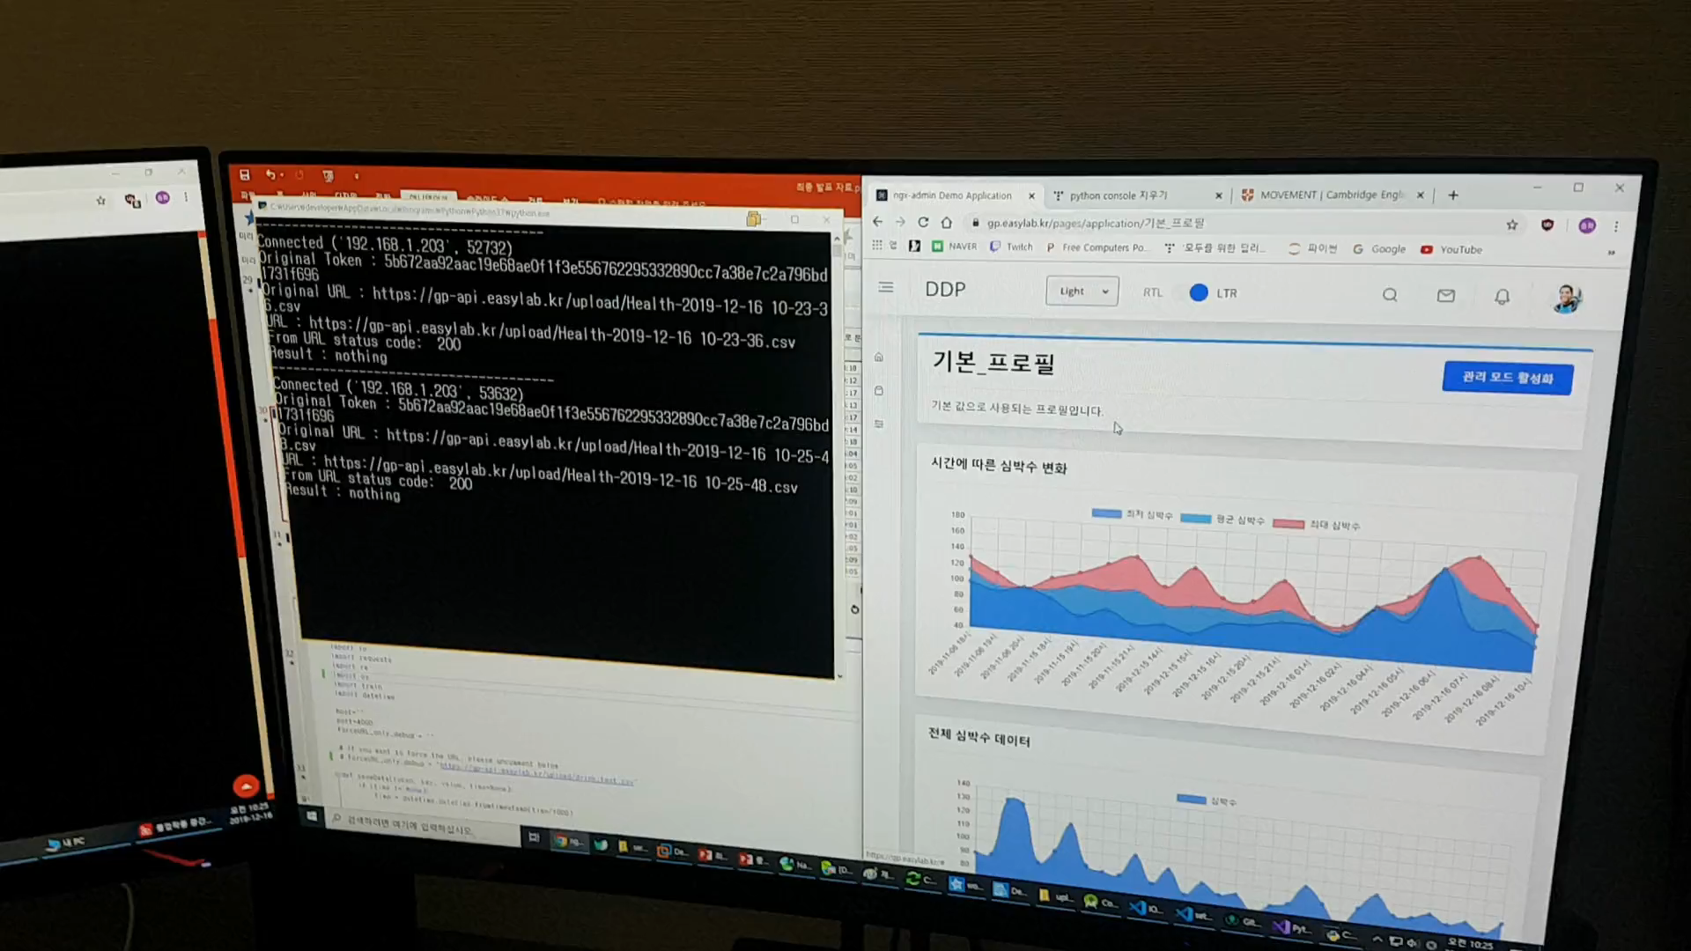
Demo

Slide 8
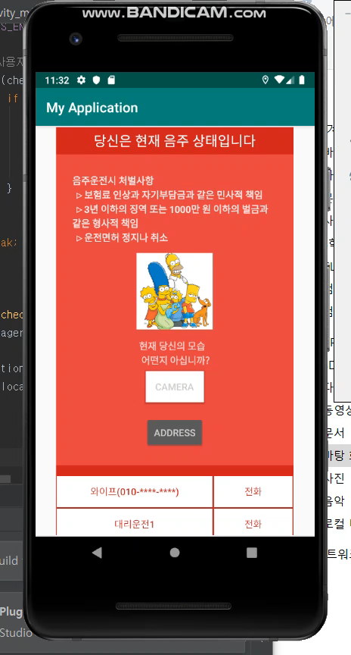
Demo
User Interface

Slide 9
Drunk Driving Prevention
Implementation
Divided approach

Slide 10
Implementation - drinking detection
Data Collection
Sensor
Heart Rate Measurement
+ Accelerometer, Gyroscope, Light
Optional
Pedometer
Activity prediction information
(NOT_MOVE, WALKING, RUNNING)

Slide 11
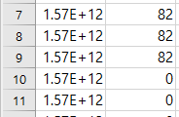
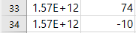
Implementation - drinking detection
Data Inspection
Problem
Preprocessing
Heart rate data included dirty data

Slide 12
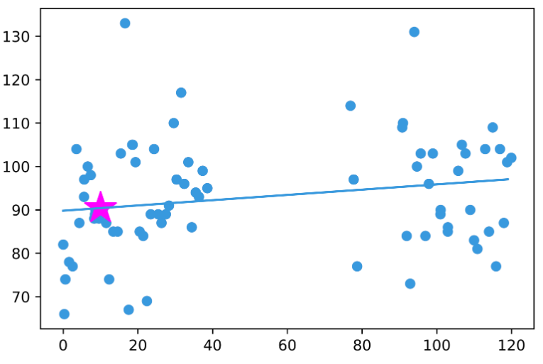
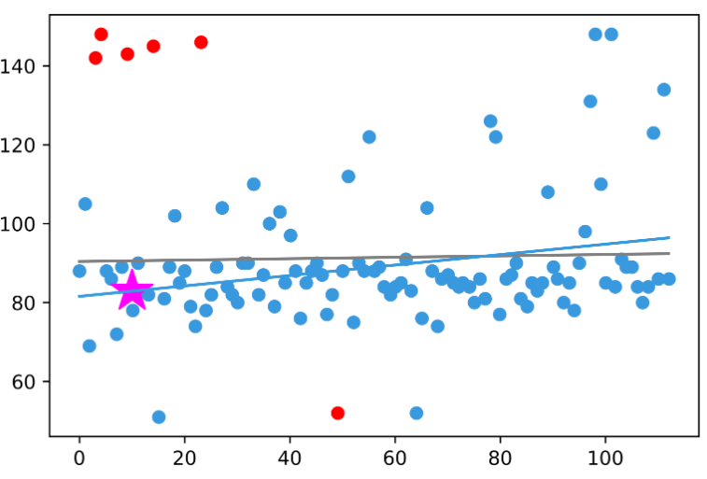
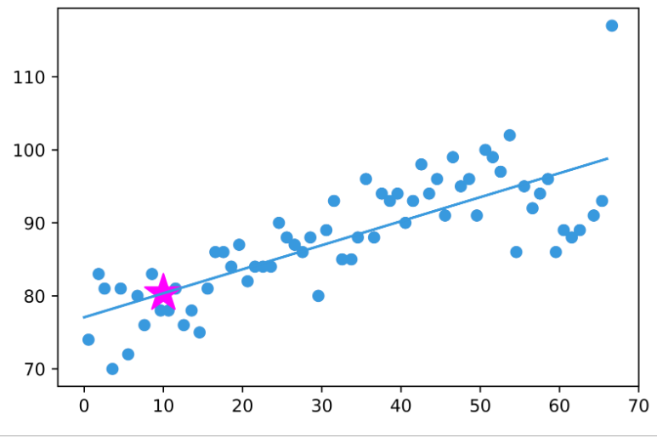
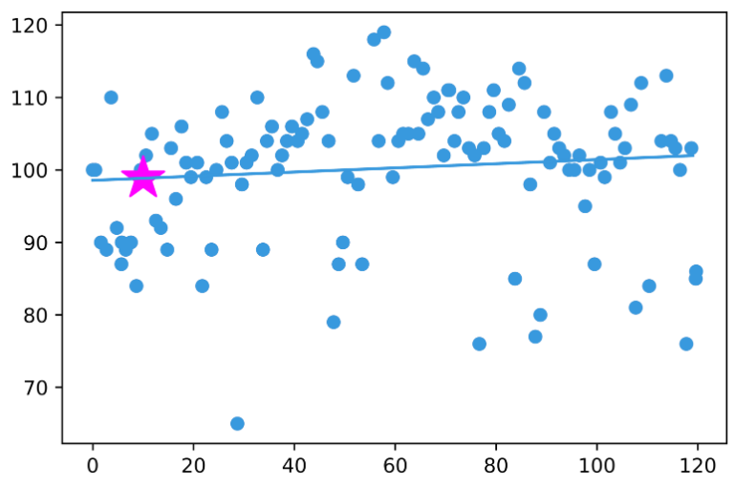
Implementation - drinking detection
X = Time
Y = Heart rate
Data Inspection
We will use this increasing pattern

Slide 13
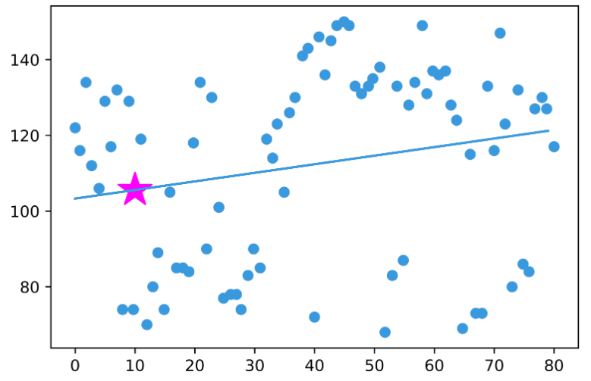
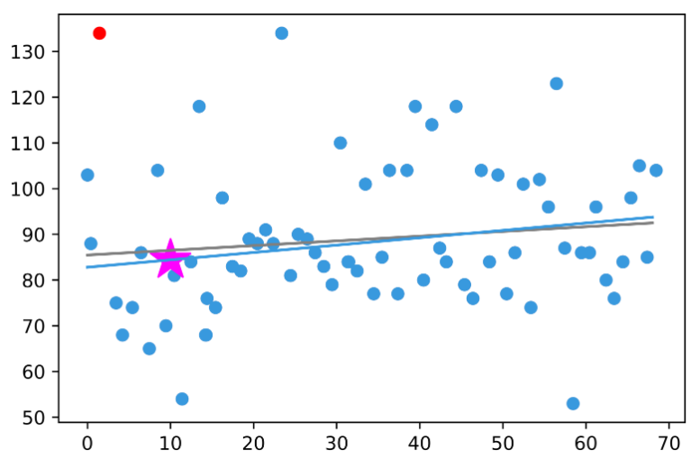
Implementation - drinking detection
X = Time
Y = Heart rate
Data Inspection
Exercise
Drink
Heart rate distribution are similar

Slide 14
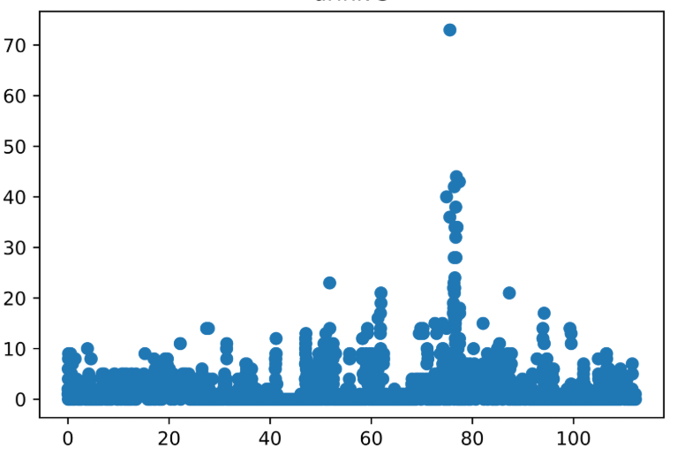
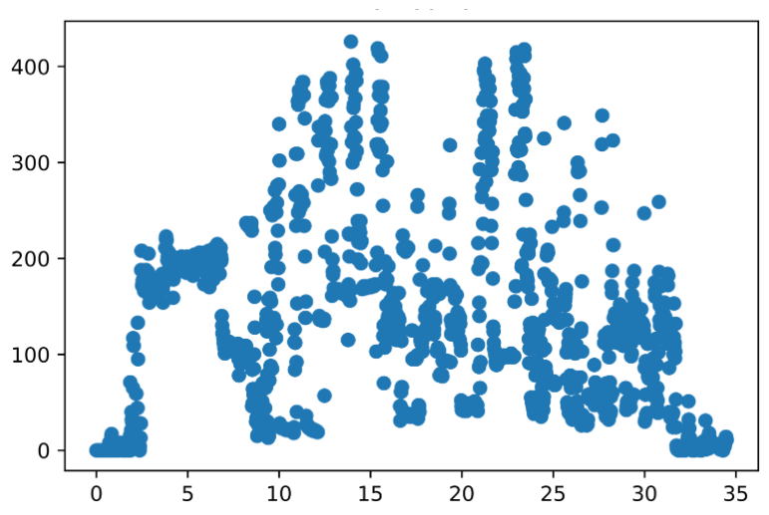
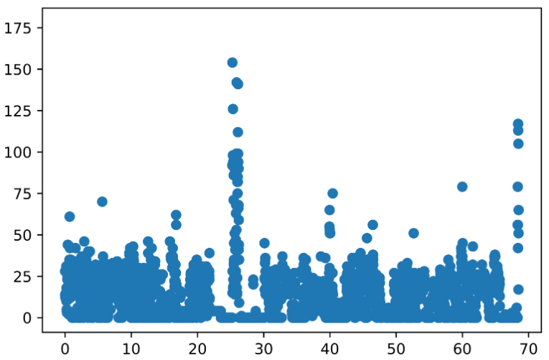
Implementation - drinking detection
X = Time
Y = Light
Data Inspection
Exercise
Drink
Exercise is often done in brightly lit areas
Drinking is not it (of course, there are exceptions)

Slide 15
Implementation - drinking detection
Data Preprocessing
Key feature extraction
Heart rate
Use predicted 10’s times and 100’s times data
Others sensor
Replace data to Representative values (such as mean, standard deviation…)

Slide 16
Implementation - drinking detection
Model
Result
To cope with lack of data, data was divided by time and duration

Slide 17
Drunk Driving Prevention
Implementation
To drive

Slide 18
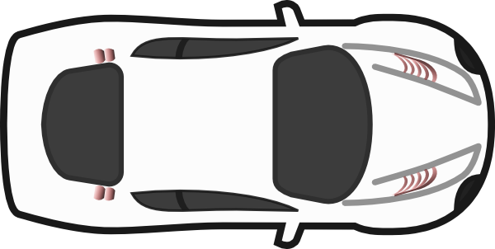

Implementation – driving detection
Used beacon’s RSSI
Sum of signal strength
-> to detect in/outsize of the vehicle.
Compare each signal
-> to detect driver when inside.

Slide 19
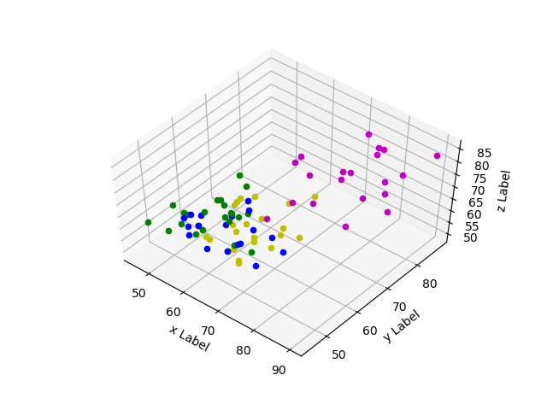
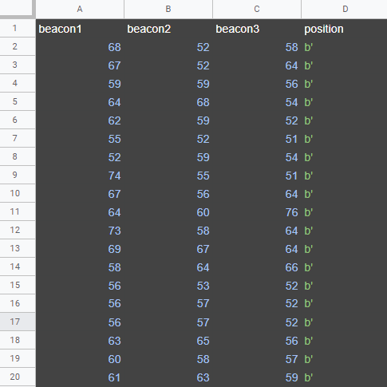
Implementation – driving detection
Inside / Outside
Total 184 data
Clearly separated

Slide 20
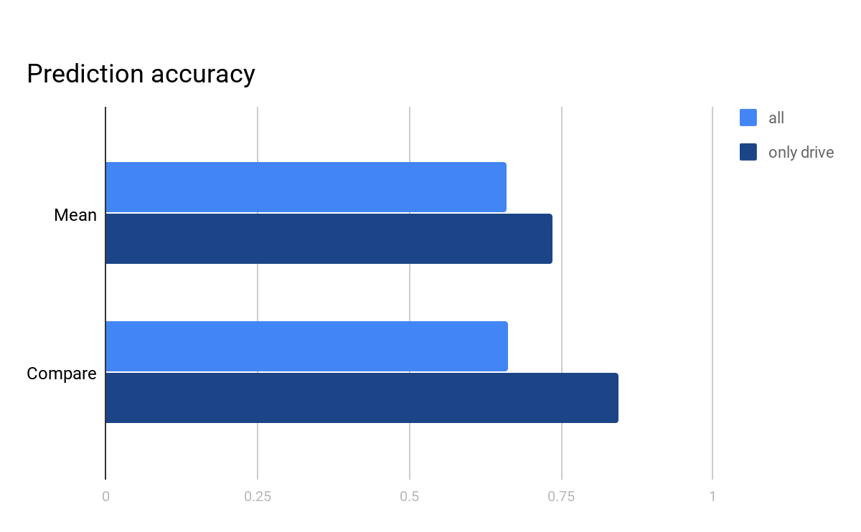
Implementation – driving detection
Driver Position
Comparing RSSI values ​​of each beacon is more accurate

Slide 21
Drunk Driving Prevention
Implementation
Environment

Slide 22
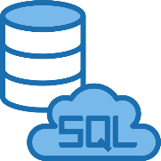
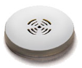
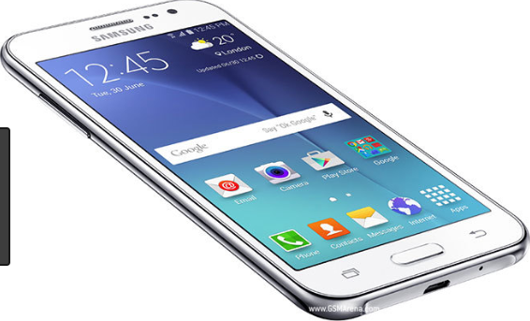


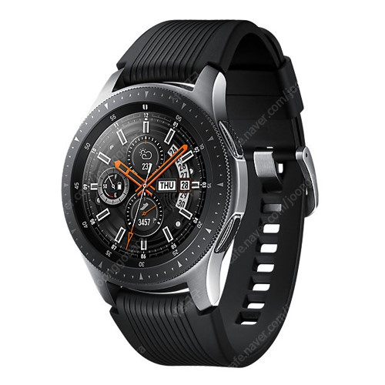
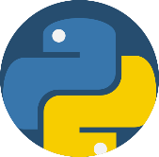
Implementation - environment
Overall
Beacon
RSSI
UI, Result
Smart Phone
API(send)
Sensor
Smart Watch
Python

Slide 23
Implementation - environment
Smart Watch & Smart Phone
Main Objective
Collect and save sensor data
Remove data (received 100 minutes ago)
Web View (UI)
Trigger for detection drinking
Check you located in car?

Slide 24
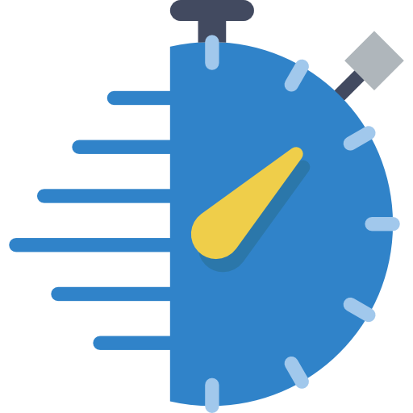
Implementation - environment
Smart Watch & Smart Phone
Trigger for detection drinking
Default: Every 60 minutes
1 +
(current heart rate - stable heart rate)
if you have a drinking signal
Check Frequently

Slide 25

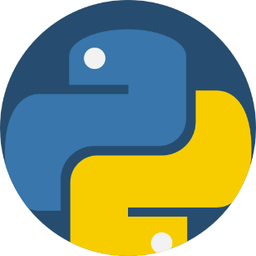
Implementation - environment
Web Server
Main Objective
Implement user interface (allow mobile, PC)
Execute ML Function (included data processing)
Save user data
Python

Slide 26

Implementation - environment
User Interface
Web-based UI
Using Angular 8 (typescript)
Design
ngx-admin (github)
-> It provides features like sample layouts and charts

Slide 27
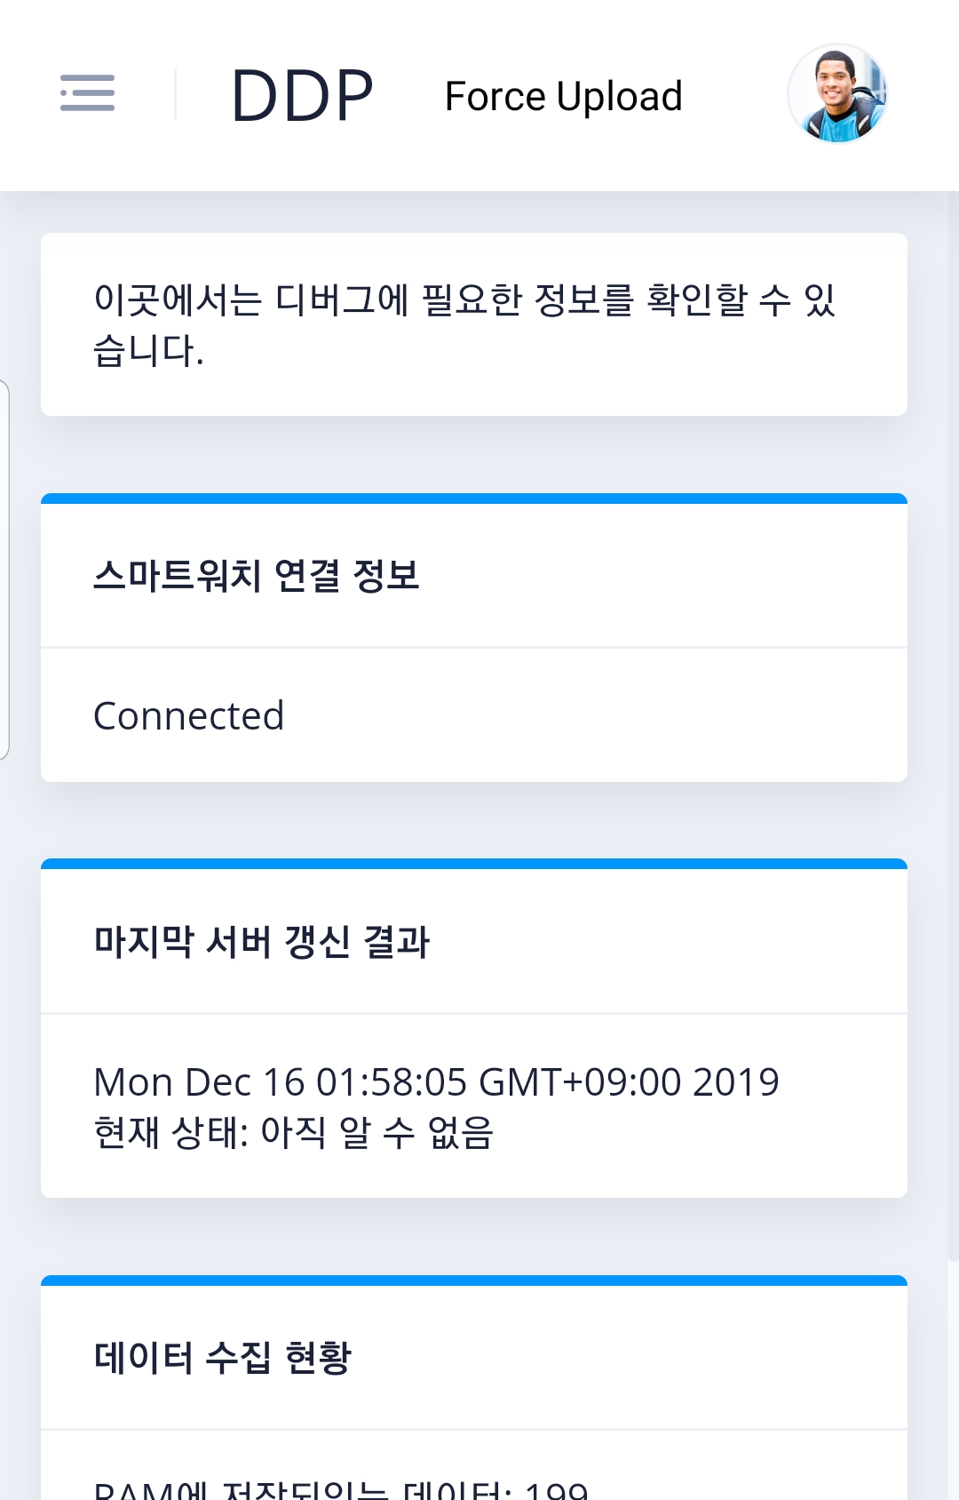
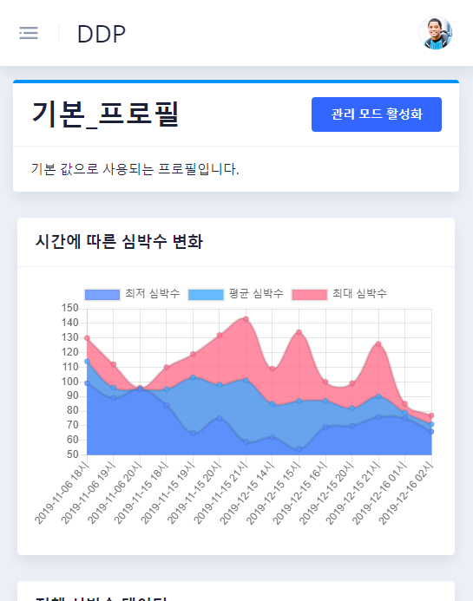
Implementation - environment
User Interface

Slide 28
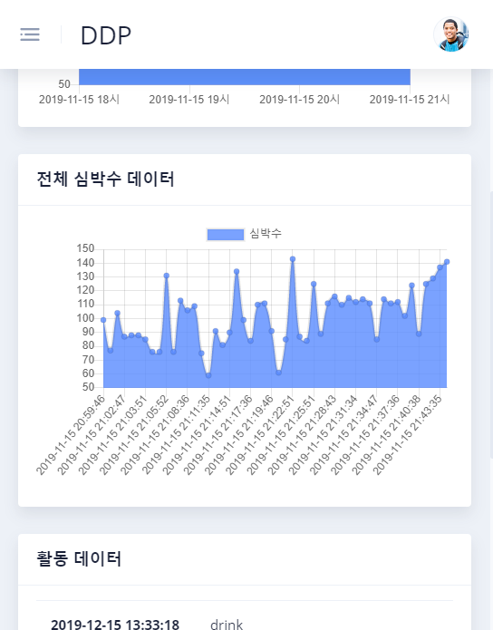
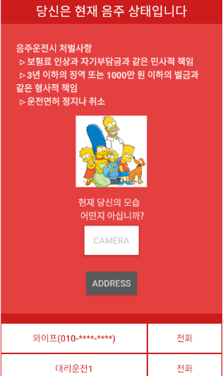
Implementation - environment
User Interface
Detected to try drunk driving

Slide 29
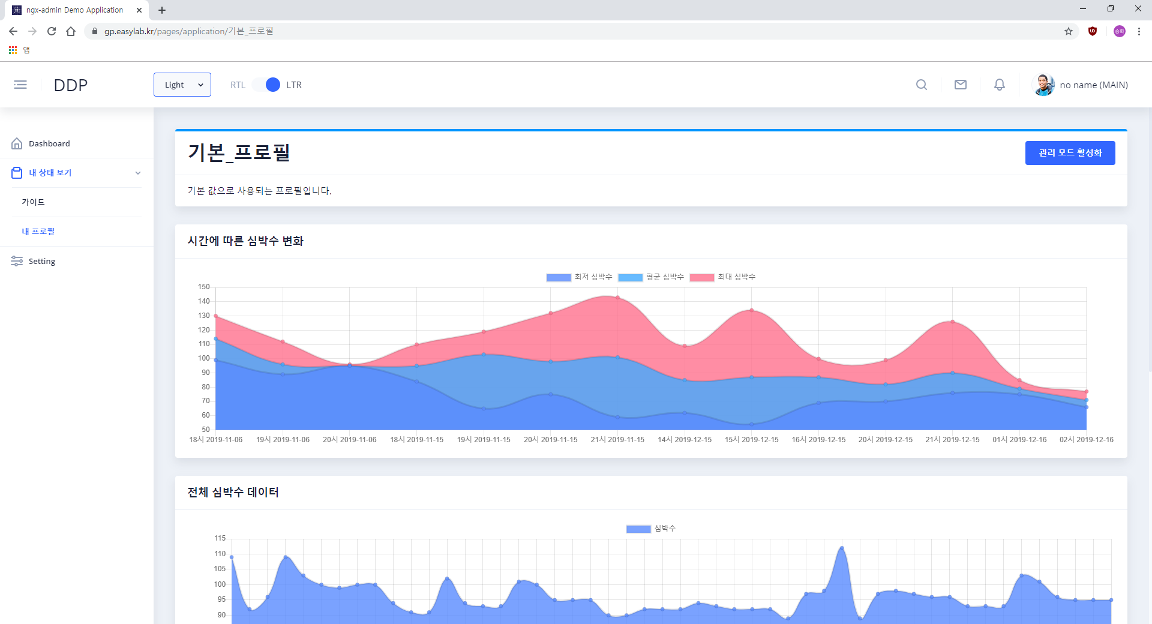
Implementation - environment
User Interface (PC)

Slide 30
Drunk Driving Prevention
Marketing Plan

Slide 31
Marketing Plan
Marketing Plan Contents
1. Situation Analysis
2. Objective and Strategy
3. Tactic and Action

Slide 32
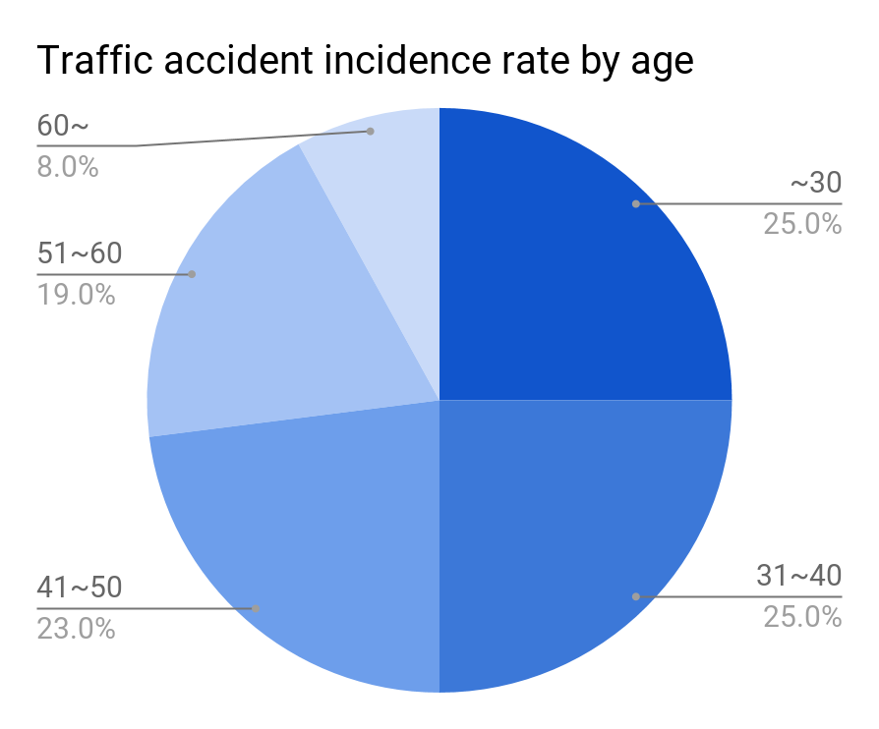
Marketing Plan
Status Analysis
Target customer
20~60 year old car owner using a smart watch
Core value
Prevent accidents by detecting and predicting drinking and driving through smart watches.

Slide 33
Marketing Plan
SWOT Analysis
Can use existing smart phones and smart watches without the need to install a breathalyzer.
Predicting driving behavior after drinking, it can be prevented by giving a warning to the user before drinking driving occurs.
User must wear a sensing device while drinking and driving, but it is difficult to force it.
S
W
O
T
Wearable sensor regulation(e.g. ECG) are relaxed. Therefore, we can utilize more sensors. (2020-03)
As the seriousness has been emphasized, such as intensifying punishment for drunk driving, it may emerge as a new solution.
Enhancement of Personal Information Protection Act

Slide 34
Marketing Plan
Objective and Strategy Setting
Improve accuracy
Customer satisfaction will come from high accuracy. With steady data collection, age and even individual data are used to increase the forecast rate.
Add drinking record analysis
Checking drinking data measured by a smart watch on a smartphone to manage users own drinking habits to satisfy users interest in health.
Add communication function
Add a function based on user own drinking data to provide motivation to continue the user’s goal drinking habits and programs.

Slide 35
Marketing Plan
Tactic and Action plan
Promote through SNS
Put a video or a poster on SNS and aim for an advertising effect without incurring large costs
Data collection to increase accuracy is also collected only for those who have voluntary intention.
Activate the communication model
To share his drinking data through the app and leave comments with his family or others, keeps the user as a steady communication place.
Collect opinions of users
After activating the high accuracy and communication model, the opinions of users are collected and reflected in the update.

Slide 36
Drunk Driving Prevention
Future Works
We've specified in detail what can be improved for other contributor in this project.

Slide 37

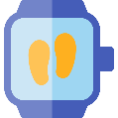
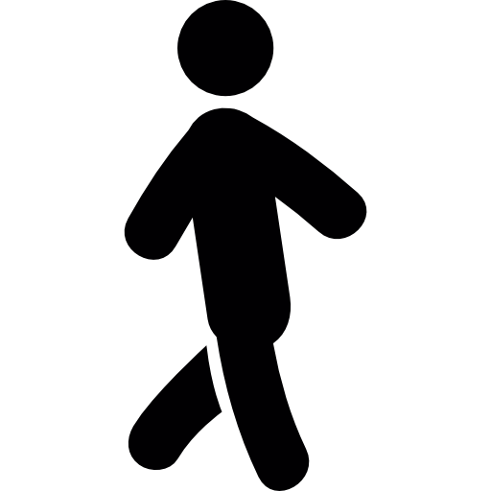

Future Works
1. Improve Feature Engineering
We have confirmed that the values ​​of the rotation sensors are not continuous. (ex. 0, 360 means same angle but different value)
Therefore, we will modify the rotation value to have a continuous range by trigonometric function.
2. Improve Prediction Algorithm
We will refer to the paper (CNN-based IoT stream data classification)
3. Improve Energy Efficiency
It is a high cost to periodically communicate with the server over the network.
We will use TensorFlow lite to predict drinking on smartphone.

Slide 38
Member Role
Member Role
이승화
권수환
전주영
Project design
Drinking detection
GitHub Management
Driving detection
Marketing plan
Android application
User interface
GitHub Management

Slide 39
Thank you ☺

